Slide 1
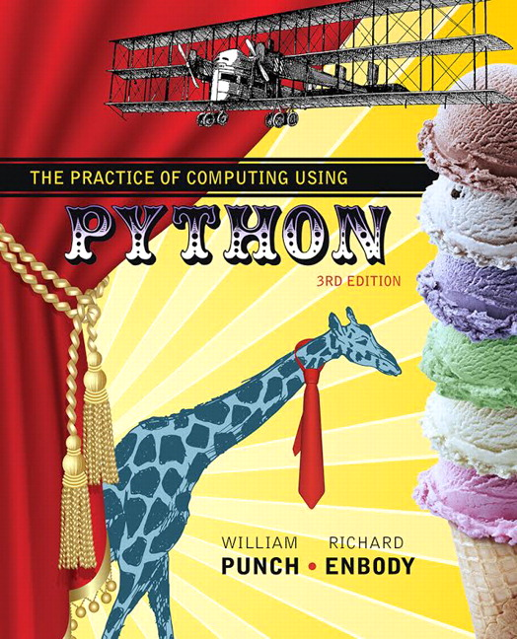
The Practice of Computing Using Python
Third Edition
Chapter 9
Dictionaries and Sets
Copyright © 2017, 2013, 2011 Pearson Education, Inc. All Rights Reserved
Notes:
If this PowerPoint presentation contains mathematical equations, you may need to check that your computer has the following installed:
1) MathType Plugin
2) Math Player (free versions available)
3) NVDA Reader (free versions available)

Slide 2
More Data Structures
We have seen the list data structure and what it can be used for
We will now examine two more advanced data structures, the Set and the Dictionary
In particular, the dictionary is an important, very useful part of python, as well as generally useful to solve many problems.

Slide 3
Dictionaries

Slide 4
What is a dictionary?
In data structure terms, a dictionary is better termed an associative array, associative list or a map.
You can think if it as a list of pairs, where the first element of the pair, the key, is used to retrieve the second element, the value.
Thus we map a key to a value

Slide 5
Key Value pairs
The key acts as an index to find the associated value.
Just like a dictionary, you look up a word by its spelling to find the associated definition
A dictionary can be searched to locate the value associated with a key

Slide 6
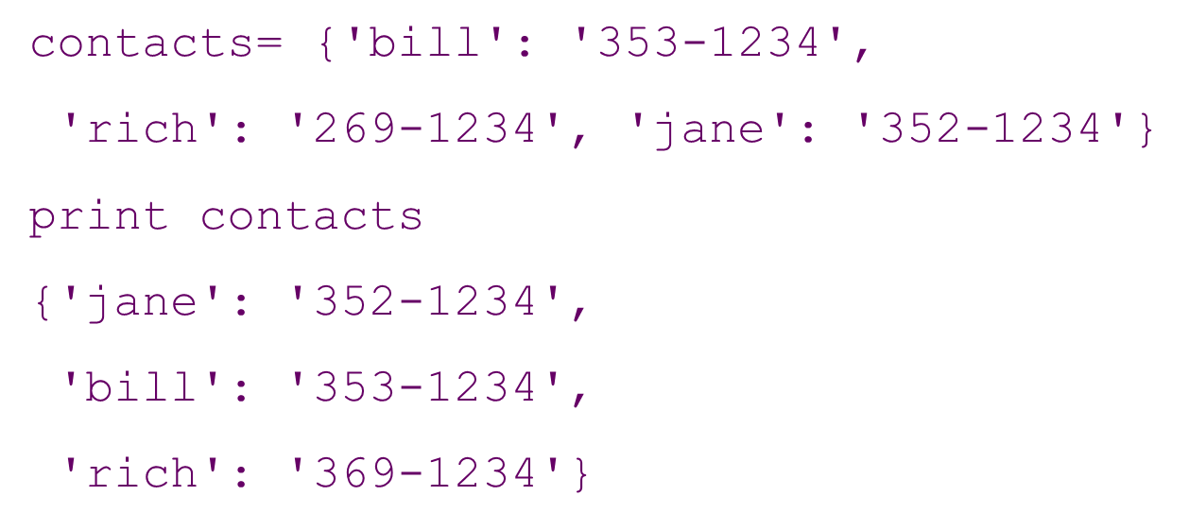
Python Dictionary
Use the { } marker to create a dictionary
Use the : marker to indicate key: value pairs

Slide 7
Figure 9.1 Phone Contact List: Names and Phone Numbers

Slide 8
Keys and Values
Key must be immutable
strings, integers, tuples are fine
lists are NOT
Value can be anything

Slide 9
Collections but Not a Sequence
dictionaries are collections but they are not sequences such as lists, strings or tuples
there is no order to the elements of a dictionary
in fact, the order (for example, when printed) might change as elements are added or deleted.
So how to access dictionary elements?

Slide 10
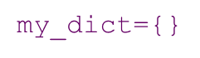
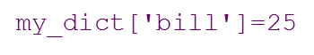
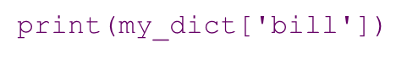
Access dictionary elements
Access requires [ ], but the key is the index!
an empty dictionary
added the pair 'bill':25
prints 25

Slide 11
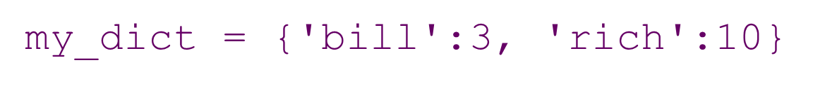
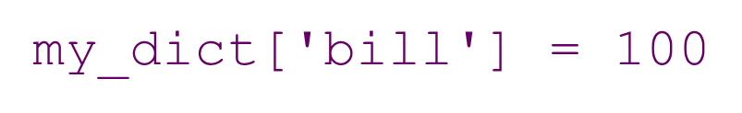
Dictionaries are mutable
Like lists, dictionaries are a mutable data structure
you can change the object via various operations, such as index assignment

Slide 12
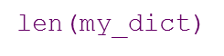
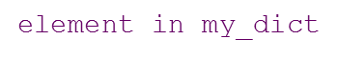
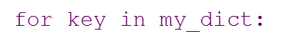
Again, Common Operators
Like others, dictionaries respond to these
number of key: value pairs in the dictionary
boolean, is element a key in the dictionary
iterates through the keys of a dictionary

Slide 13
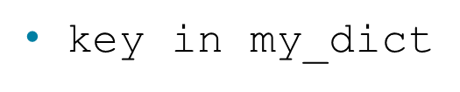
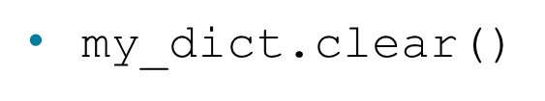
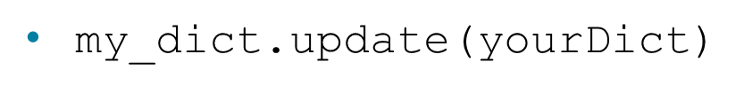
Fewer Methods
Only 9 methods in total. Here are some
does the key exist in the dictionary
– empty the dictionary
– for each key
my_dict.copy
– shallow copy
my_dict.pop(key)
– remove key, return value

Slide 14
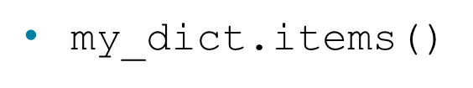

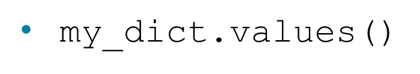
Dictionary content methods
– all the key/value pairs
– all the keys
– all the values
There return what is called a dictionary view.
the order of the views corresponds
are dynamically updated with changes
are iterable

Slide 15
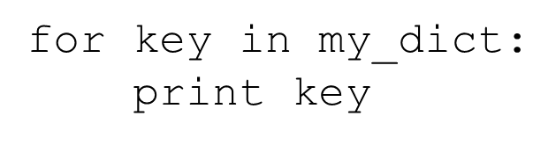
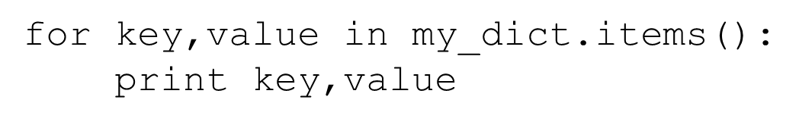
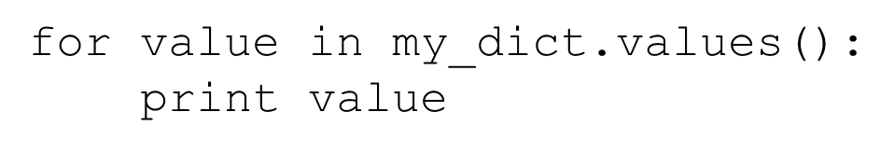
Views are Iterable
prints all the keys
prints all the key/value pairs
prints all the values

Slide 16
Operators

Slide 17
Frequency of words in list 3 ways

Slide 18
Membership Test

Slide 19
Get Method
get method returns the value associated with a dict key or a default value provided as second argument. Below, the default is 0

Slide 20


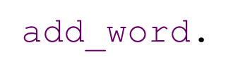


4 Functions 1
Add word to the dictionary. No return
Process line and identify words. Calls
No return.
Nice printing of the dictionary contents. No return
Function to start the program.

Slide 21
Passing Mutables
Because we are passing a mutable data structure, a dictionary, we do not have to return the dictionary when the function ends
If all we do is update the dictionary (change the object) then the argument will be associated with the changed object.

Slide 22
Code Listings 9.2

Slide 23
Code Listings 9.3

Slide 24
Sorting In Pretty_print
the sort method works on lists, so if we sort we must sort a list
for complex elements (like a tuple), the sort compares the first element of each complex element:
(1, 3) < (2, 1) # True
(3,0) < (1,2,3) # False
a list comprehension (commented out) is the equivalent of the code below it

Slide 25
Code Listings 9.4

Slide 26
Code Listings 9.5

Slide 27
Periodic Table example

Slide 28
Comma Separated Values (C S V)
C S V files are a text format that are used by many applications (especially spreadsheets) to exchange data as text
row oriented representation where each line is a row, and elements of the row (columns) are separated by a comma
despite the simplicity, there are variations and we'd like Python to help

Slide 29
C S V Module
csv.reader takes an opened file object as an argument and reads one line at a time from that file
Each line is formatted as a list with the elements (the columns, the comma separated elements) found in the file

Slide 30
Encodings other than UTF-8
this example uses a csv file encoded with characters other than UTF-8 (our default)
in particular, the symbol ± occurs
can solve by opening the file with the correct encoding, in this case windows-1252

Slide 31
Example 1

Slide 32
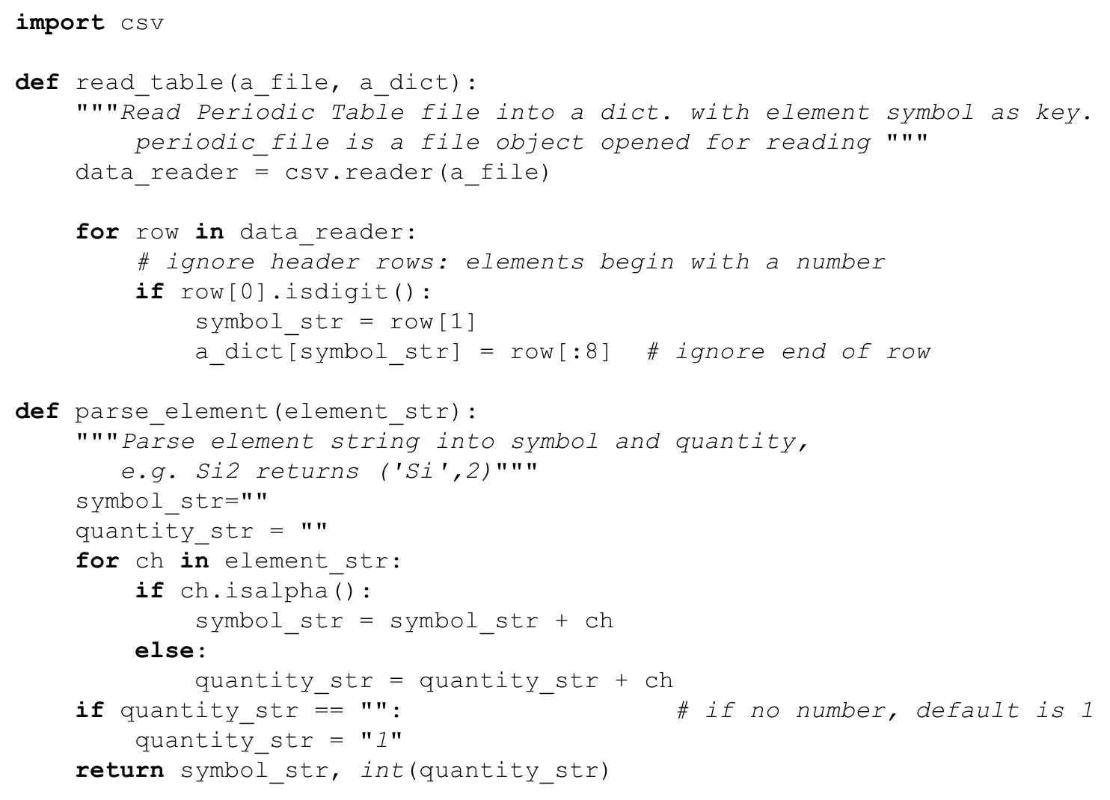
Code Listings 9.8 (1 of 2)

Slide 33
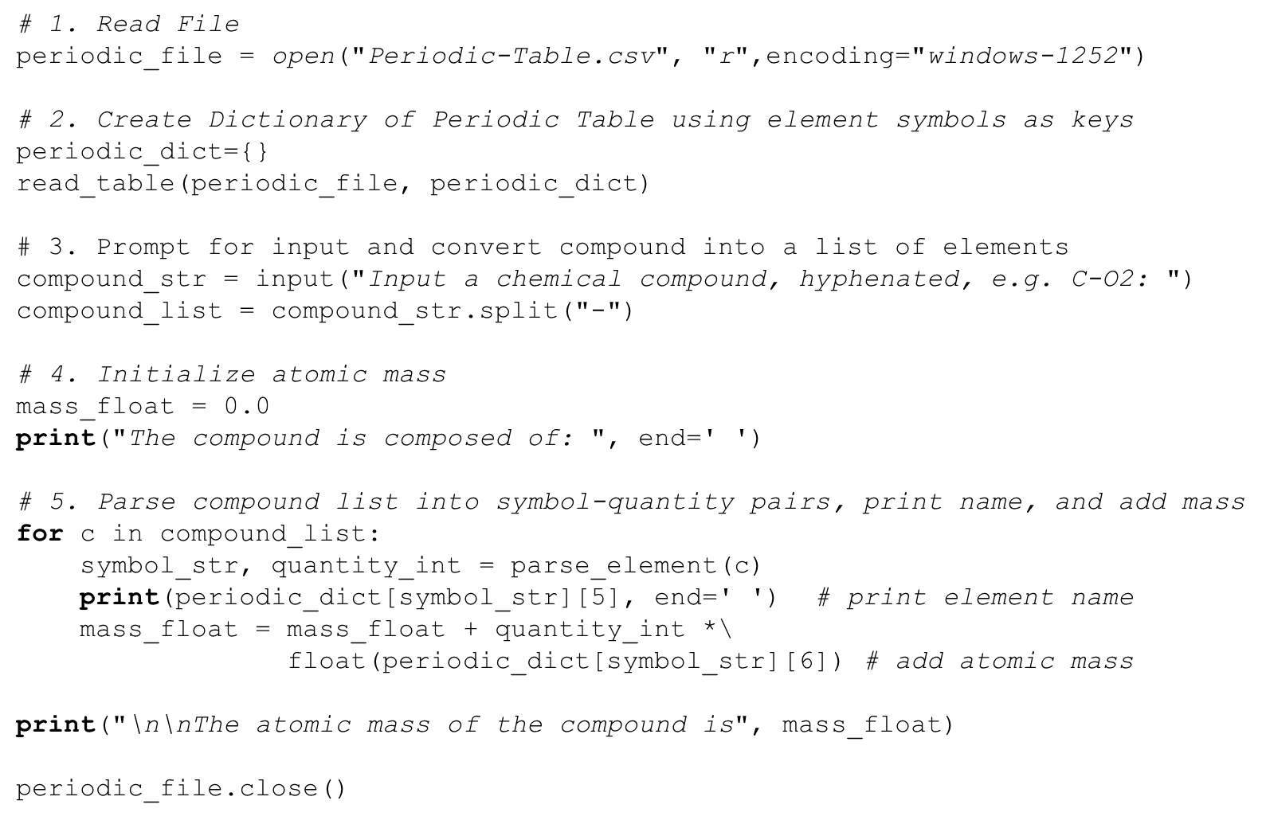
Code Listings 9.8 (2 of 2)

Slide 34
Sets

Slide 35
Sets, as in Mathematical Sets
in mathematics, a set is a collection of objects, potentially of many different types
in a set, no two elements are identical. That is, a set consists of elements each of which is unique compared to the other elements
there is no order to the elements of a set
a set with no elements is the empty set

Slide 36
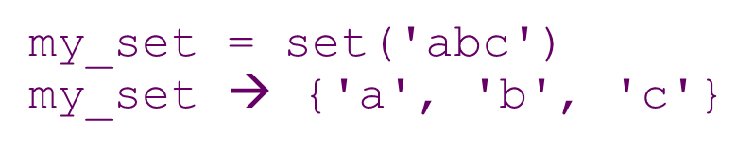
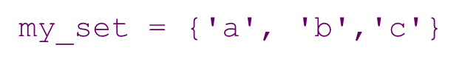
Creating a Set
Set can be created in one of two ways:
constructor: set(iterable) where the argument is iterable
shortcut: {}, braces where the elements have no colons (to distinguish them from dicts)

Slide 37
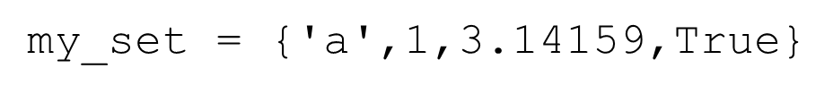
Diverse elements
A set can consist of a mixture of different types of elements
as long as the single argument can be iterated through, you can make a set of it

Slide 38
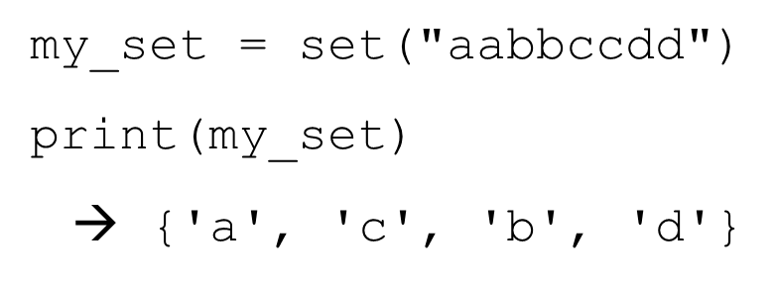
No Duplicates
duplicates are automatically removed

Slide 39
Example 2

Slide 40
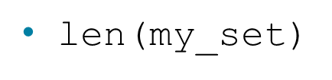
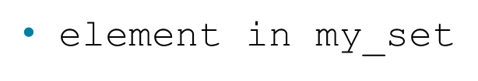
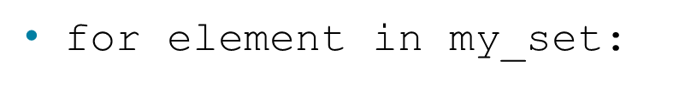
Common Operators
Most data structures respond to these:
the number of elements in a set
boolean indicating whether element is in the set
iterate through the elements in

Slide 41
Set Operators
The set data structure provides some special operators that correspond to the operators you learned in middle school.
These are various combinations of set contents
These operations have both a method name and a shortcut binary operator

Slide 42
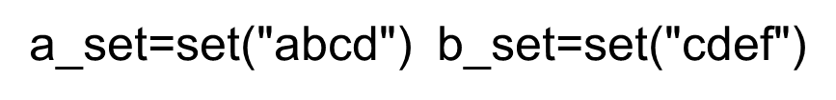
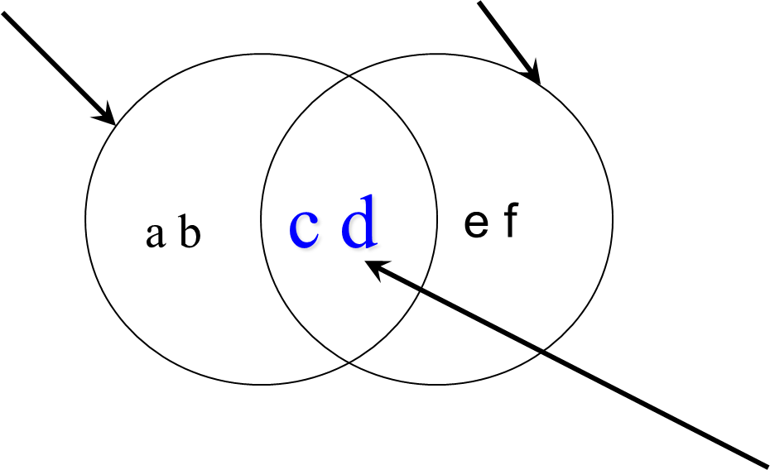
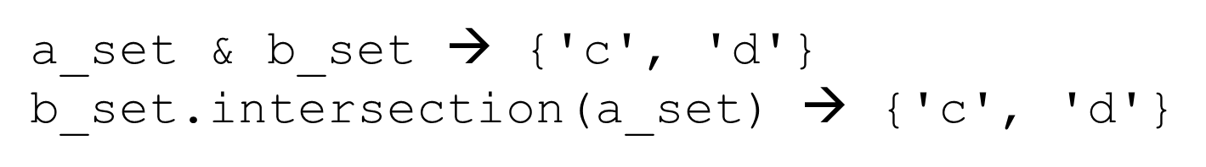
Method: Intersection, O p colon ampersand

Slide 43
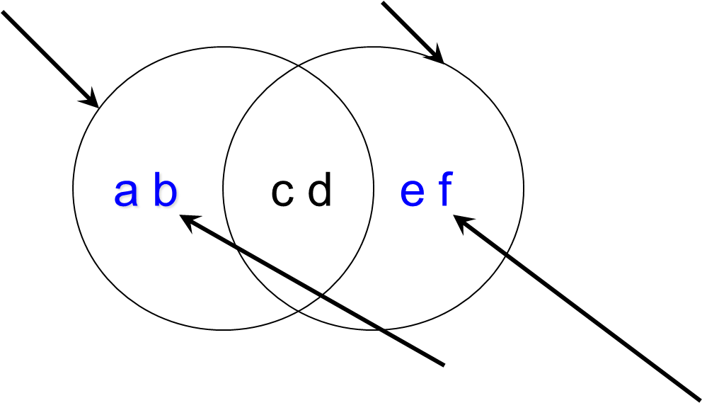
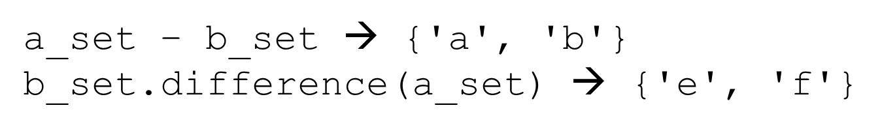
Method: Difference

Slide 44
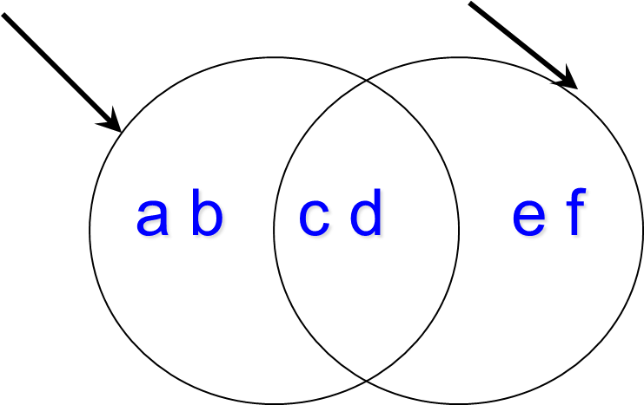
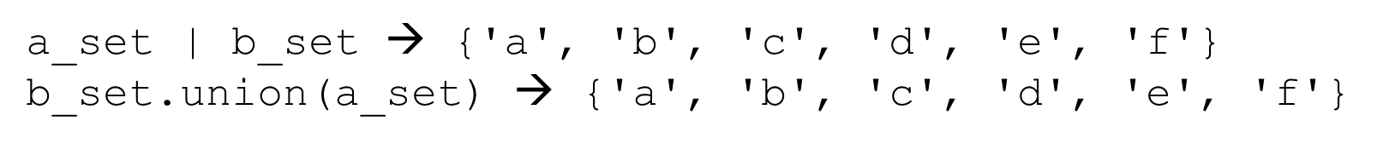
Method: Union, O P colon pipe

Slide 45
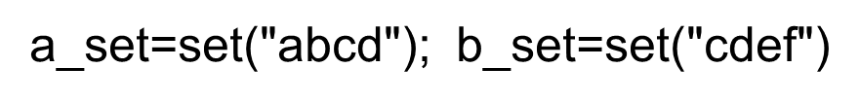
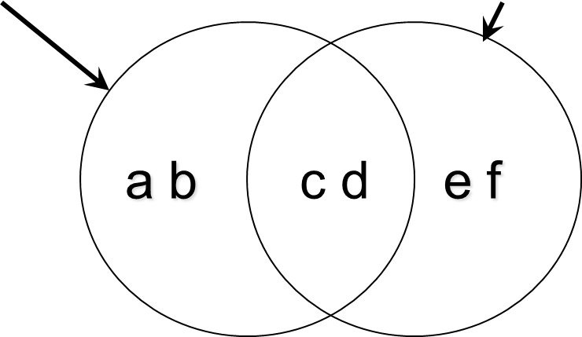
Method: symmetric_difference, O P colon Caret.

Slide 46
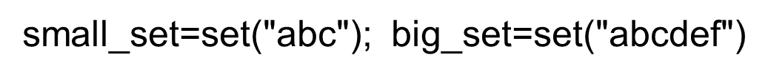
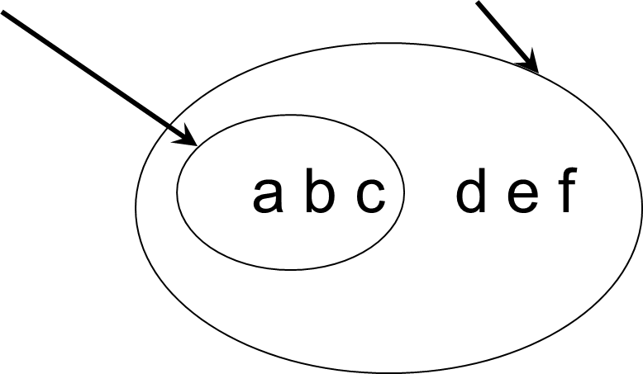
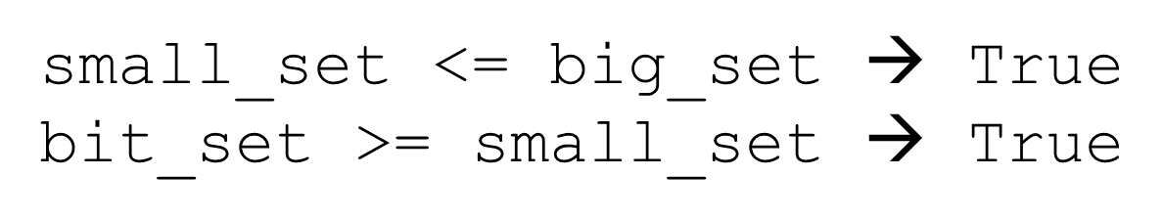
Method: Issubset, O P colon less than equals Method: Issuperset, O P colon greater than equals

Slide 47
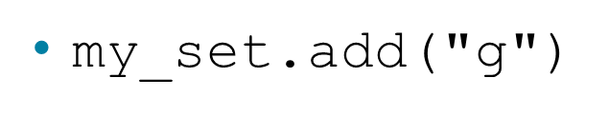
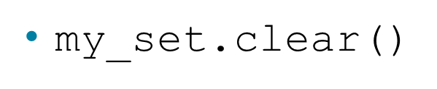
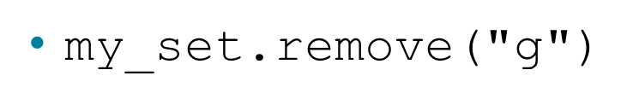
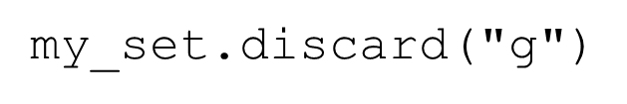

Other Set Ops
adds to the set, no effect if item is in set already
emptys the set
versus
remove throws an error if "g" isn't there. discard doesn't care. Both remove "g" from the set
returns a shallow copy of

Slide 48
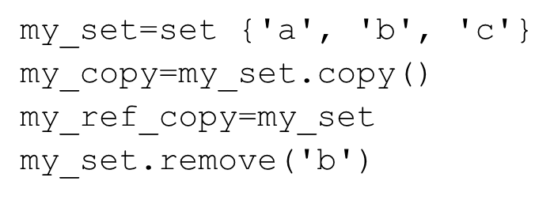
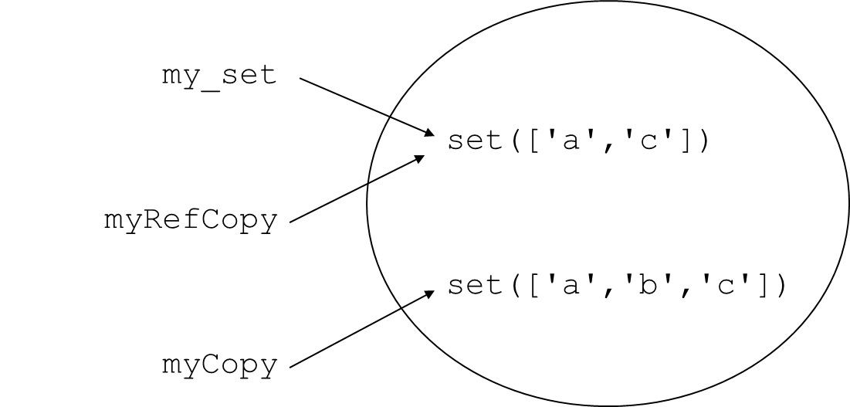
Copy Versus assignment

Slide 49
Common words in Gettysburg Address and Declaration of Independence
can reuse or only slightly modify much of the code for document frequency
the overall outline remains much the same
for clarity, we will ignore any word that has three characters or less (typically stop words)

Slide 50
4 functions 2
add_word(word, word_set). Add word to the set (instead of dict). No return.
process_line(line, word_set). Process line and identify words. Calls add_word. No return. (no change except for parameters)
pretty_print(word_set). Nice printing of the various set operations. No return
main(). Function to start the program.

Slide 51
Code Listings 9.9

Slide 52
Code Listings 9.10

Slide 53
More Complicated Pretty Print
the pretty_print function applies the various set operators to the two resulting sets
prints, in particular, the intersection in a nice format
should this have been broken up into two functions??

Slide 54
Code Listings 9.12

Slide 55
More on Scope

Slide 56
OK, What is a Namespace
We’ve had this discussion, but lets’ review
A namespace is an association of a name and a value
It looks like a dictionary, and for the most part it is (at least for modules and classes)

Slide 57
Scope
What namespace you might be using is part of identifying the scope of the variables and function you are using
by "scope", we mean the context, the part of the code, where we can make a reference to a variable or function

Slide 58
Multiple scopes
Often, there can be multiple scopes that are candidates for determining a reference.
Knowing which one is the right one (or more importantly, knowing the order of scope) is important

Slide 59
Two kinds
Unqualified namespaces. This is what we have pretty much seen so far. Functions, assignments etc.
Qualified namespaces. This is modules and classes (we'll talk more about this one later in the classes section)

Slide 60
Unqualified
this is the standard assignment and def we have seen so far
Determining the scope of a reference identifies what its true 'value' is

Slide 61
Unqualified follow the LEGB rule
local, inside the function in which it was defined
if not there, enclosing/encomposing. Is it defined in an enclosing function
if not there, is it defined in the global namespace
finally, check the built-in, defined as part of the special builtin scope
else ERROR

Slide 62
locals()function
Returns a dictionary of the current (presently in play) local namespace. Useful for looking at what is defined where.

Slide 63
Function local values
if a reference is assigned in a function, then that reference is only available within that function
if a reference with the same name is provided outside the function, the reference is reassigned

Slide 64
Code Listings 9.13
global is still found
because of the
sequence of namespace
search

Slide 65
globals() function
Like the locals() function, the
globals() function will return as a dictionary the values in the global namespace

Slide 66
Code Listings 9.14 (1 of 2)

Slide 67
Code Listings 9.14 (2 of 2)

Slide 68
Global Assignment Rule
A quirk of Python.
If an assignment occurs anywhere in the suite of a function, Python adds that variable to the local namespace
means that, even if the variable is assigned later in the suite, the variable is still local

Slide 69
Code Listings 9.15
my_var is local (is in the local namespace)
because it is assigned in the suite

Slide 70
the global statement
You can tell Python that you want the object associated with the global, not local namespace, using the global statement
avoids the local assignment rule
should be used carefully as it is an over-ride of normal behavior

Slide 71
Code Listings 9.16
my_var is not in the local namespace

Slide 72
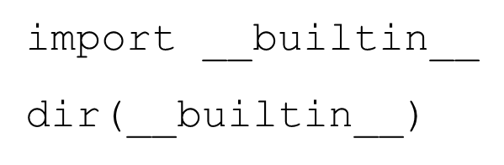
Builtin
This is just the standard library of Python.
To see what is there, look at

Slide 73
Enclosed
Functions which define other functions in a function suite are enclosed, defined only in the enclosing function
the inner/enclosed function is then part of the local namespace of the outer/enclosing function
remember, a function is an object too!

Slide 74
Code Listings 9.18 (1 of 2)

Slide 75
Code Listings 9.18 (2 of 2)

Slide 76
Building dictionaries faster
zip creates pairs from two parallel lists
zip("abc",[1,2,3]) yields
[('a',1),('b',2),('c',3)]
That's good for building dictionaries. We call the dict function which takes a list of pairs to make a dictionary
dict(zip("abc",[1,2,3])) yields
{'a': 1, 'c': 3, 'b': 2}

Slide 77
Dict and Set Comprehensions
Like list comprehensions, you can write shortcuts that generate either a dictionary or a set, with the same control you had with list comprehensions
both are enclosed with {} (remember, list comprehensions were in [])
difference is if the collected item is a : separated pair or not

Slide 78
Dict Comprehension

Slide 79
Set Comprehension

Slide 80
Reminder, rules so far
Think before you program!
A program is a human-readable essay on problem solving that also happens to execute on a computer.
The best way to imporve your programming and problem solving skills is to practice!
A foolish consistency is the hobgoblin of little minds
Test your code, often and thoroughly
If it was hard to write, it is probably hard to read. Add a comment.
All input is evil, unless proven otherwise.
A function should do one thing.

Slide 81
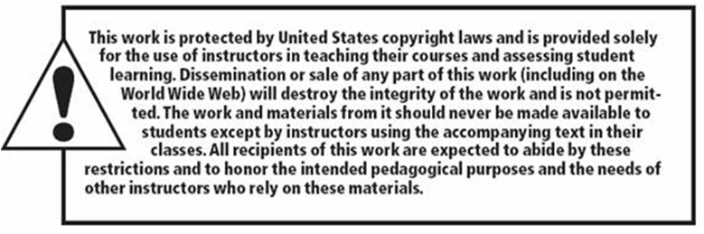
Copyright

